Slide 1
Fair Work and Inclusive Growth
Professor Patricia Findlay
Fair Work Convention
Member; Academic Adviser

Slide 2
OECD: Inclusive growth is economic growth that creates opportunity for all segments of the population and distributes the dividends of increased prosperity, both in monetary and non-monetary terms, fairly across society.
SG: We aim to achieve economic growth in Scotland that is inclusive. This means growth that combines increased prosperity with greater equality, creates opportunities for all, and distributes the benefits of increased prosperity fairly.

Slide 3
Participating
Benefitting

Slide 4
Participating
Creating (value)
Benefitting

Slide 5
Fair work is work that offers effective voice, opportunity, security, fulfilment and respect;
that balances the rights and responsibilities of employers and workers
and that can generate benefits for individuals, organisations and society.
Our vision is that,
by 2025, people in Scotland will have a world-leading working life where fair work drives success, wellbeing and prosperity for individuals, businesses, organisations and society.

Slide 6
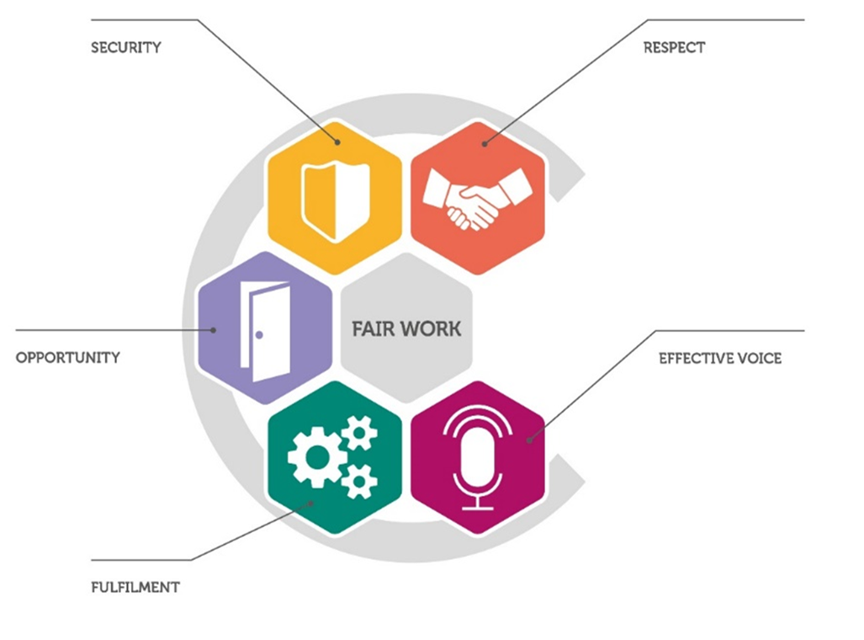

Slide 7
Thank you.

